Slide 1
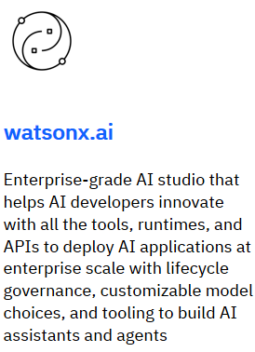


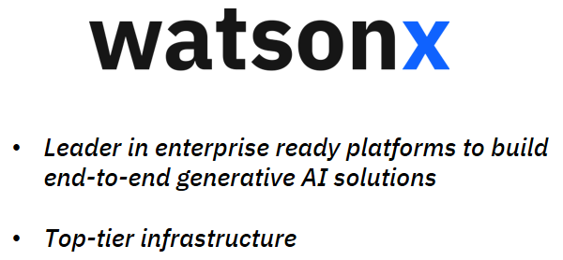
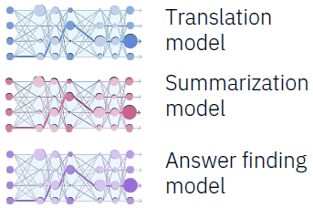

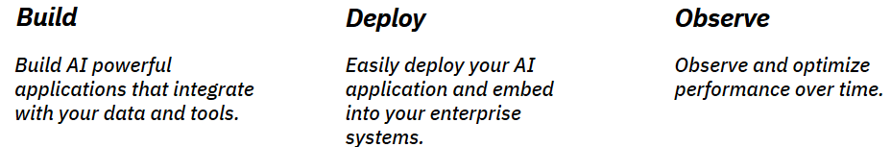

Slide 2
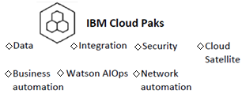
The watsonx platform has three main parts:
Watsonx.ai studio:A tool for working with foundation models, generative AI, and machine learning. For new AI models, generative AI, and machine learning.
Watsonx.data: A data storage system built with an open architecture for easy access to all your data. A data storage system built on an open lakehouse design.
Watsonx.governance: A set of tools to ensure AI workflows are responsible, transparent, and well-managed. Watsonx.governance integrates with external machine learning providers. It can support local laws and regulations.
With watsonx, you can gain a competitive advantage by using prompt engineering and fine-tuning AI models, while also managing your data better and getting high-quality AI models into production faster.
Cloud Pak for Data is a Cloud Pak that watsonx run on.
Benefits of watsonx include:
Openness: It’s based on the best open-source technologies.
Trustworthiness: It’s built to be transparent, responsible, and well-managed.
Targeted: It’s designed specifically for businesses and their needs.
Empowering: It helps create value with AI for your business.

Slide 3
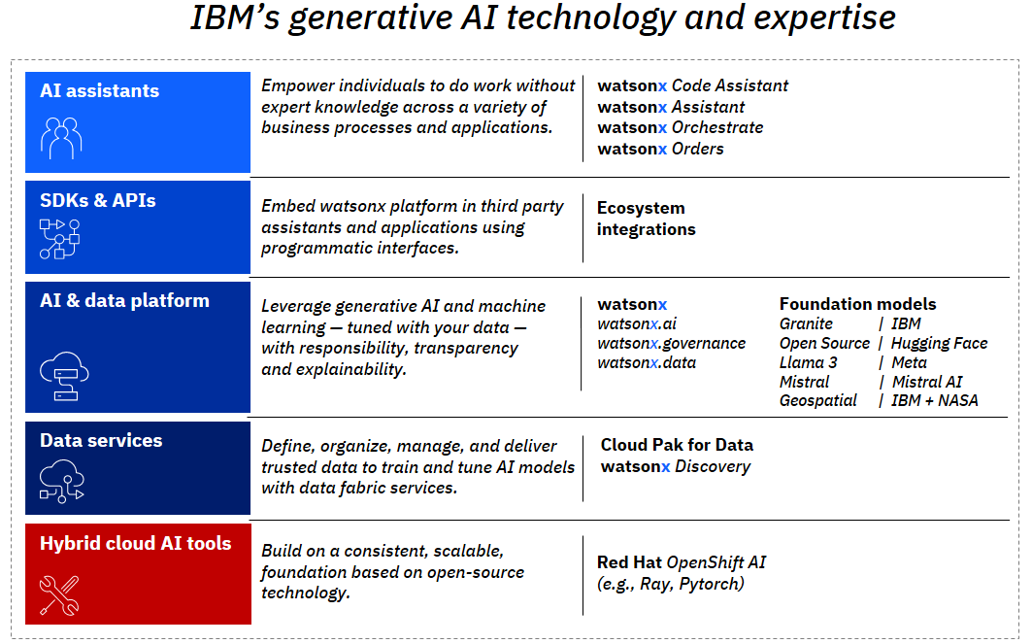

Slide 4
Transformer architecture:
A transformer is a type of deep learning system that focuses on important parts of the input using something called the "attention mechanism." This helps the model learn and understand data more effectively. A transformer is a deep-learning neural network architecture.
Paradigm shift:
A paradigm shift is a big change in the way we think about or understand something.
Generative AI:
Generative AI is a type of artificial intelligence that can create things like text, images, or other content when given instructions (called prompts).
Foundation model:
A foundation model is a large AI system that is trained on a huge amount of data. This model can then be used for many different tasks, like classifying information, summarizing text, translating languages, or helping with customer service.
Greedy or Sampling is a setting you should change to allow a foundation model to generate alternative responses.
This new way of using the internet takes advantage of foundation models to automate searching and discovering information. Other uses include creating emails, summarizing articles, translating languages, generating computer code, and providing customer support.

Slide 5
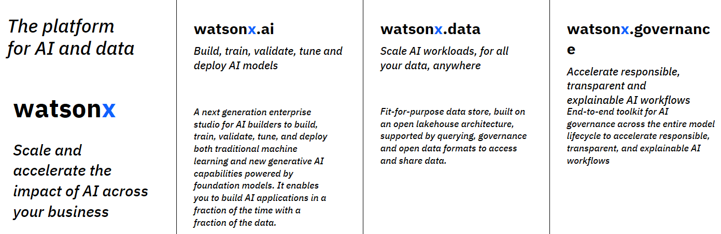
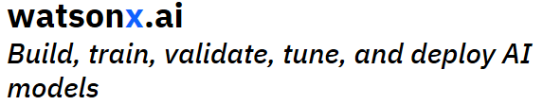

Slide 6
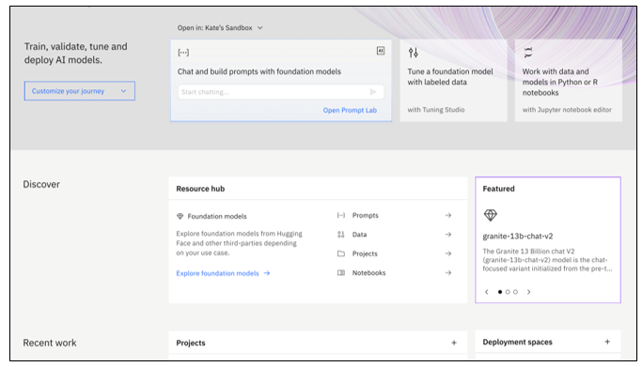
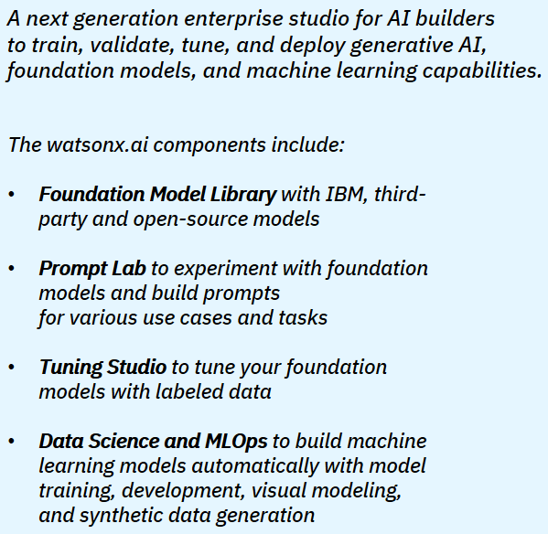
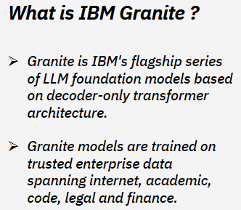
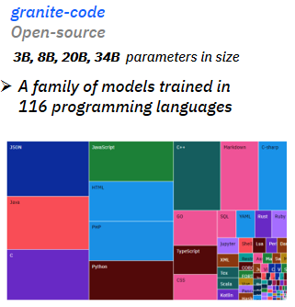

Slide 7
Types of Granite models
1. Granite-13b-chat-v2.1: A chat model optimized for dialogue use cases that works well with virtual agents and chat applications
2. Granite-13b-instruct-v2.1: An instruct model trained on high- quality finance data to perform well in finance domain tasks
3. Granite-20b-multilingual: Trained to understand and generate text in English, German, Spanish, French and Portuguese
4. Granite-8b-japanese: Designed to perform language tasks on Japanese text
5. Granite-7b-lab: Supports general-purpose tasks and is tuned using the IBM’s large-scale alignment of chatbots (LAB) methodology to incorporate new skills
6. Granite code models: A family of models trained in 116 programming languages and ranging in size from 3 to 34 billion parameters—with base model and instruction-following model variants
The number of parameters in a foundation model is one of the many factors that determine its performance.
Watson machine learning is a watsonx service required by the Prompt lab.
Instruction is the imperative statement in your prompt called that tells the foundation model what to do
For an equivalent prompt, the response generated by the Prompt Lab is independent of whether the freeform or structured way of entering prompts is utilized

Slide 8
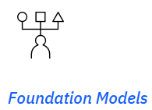
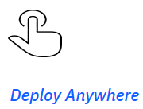
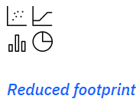
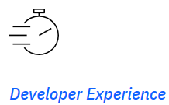
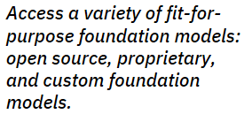


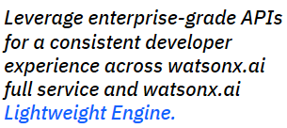
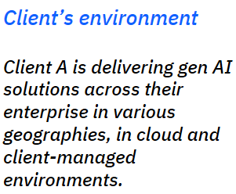
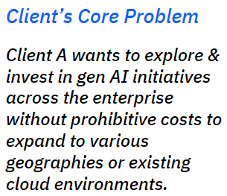

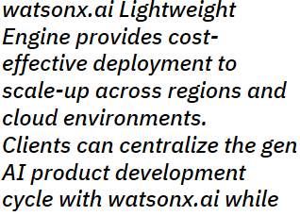
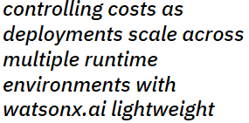

Slide 9
Even though foundation models are being used in many places, researchers, data scientists, and engineers don’t fully understand how these models work, when they might fail, or all the things they can do. Foundation models also have limitations, like bias in the data they are trained on, and any problems in these models are passed on to other systems that use them.
Much of the content and ideas here were inspired by the innovative paper titled On the Opportunities and Risks of Foundation Models. Foundation models are trained on vast amounts of data and are used for a wide range of tasks, but we are still in the early stages of understanding them.
Although foundation models have great potential, they are still new and not fully understood. Even though they are used in the real world, they are still experimental and need more research. Discussions about these models often focus on how they are built, trained, and how many data points (or parameters) they have, but they sometimes ignore the key role people play in creating and using the data.
The impact of foundation models on society depends on the entire system around them. These models can be used in many different ways, some of which we might not have expected. Just like in information security, people are often the weak link in AI systems. They create the data that trains foundation models and are also the ones affected by the benefits or problems that come from using these models.
Early versions of generative AI have faced problems with accuracy, bias, and sometimes generating false information (known as hallucinations). However, generative AI has the potential to change how businesses operate and how tasks are completed. It's important to focus on people when developing a strategy for using AI in a business.
Careful selection and preparation of data should always be part of creating responsible AI systems.

Slide 10



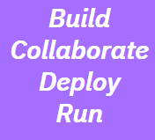
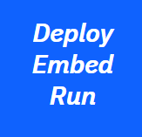
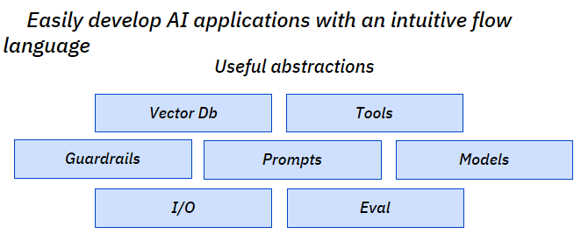
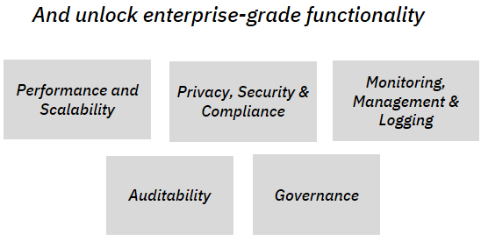

Slide 11
Artificial Intelligence (AI) refers to any system that can mimic human thinking and problem-solving.
Machine learning is a part of AI that uses data and algorithms to learn from experience, gradually getting better at its tasks.
Deep learning is a more advanced form of machine learning, using complex neural networks with many layers to process information.
Foundation models are large AI models trained on vast amounts of unlabeled data, which can be fine-tuned for different tasks with little adjustment.
To break it down:
Machine learning is a part of AI.
Deep learning is a part of machine learning.
Foundation models are a part of deep learning.
Two important concepts with foundation models are emergence and homogenization:
Emergence means that the model's behaviour comes naturally as it grows, without being directly programmed for it.
Homogenization refers to how foundation models use a common method across various tasks.
Generative AI involves algorithms that create new content like text, images, code, or sound based on what it has learned from its training data.

Slide 12
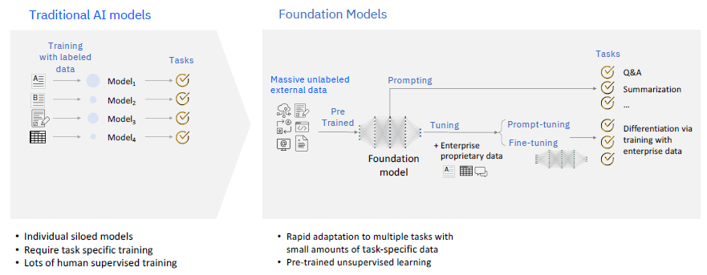

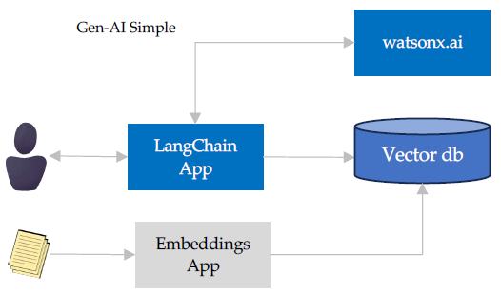
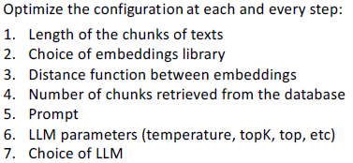

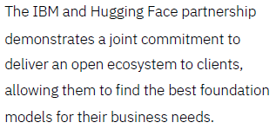
LangChain is an open-source framework designed to simplify creating applications
using LLMs.
How to improve accuracy

Slide 13
Note: Foundation models can show unexpected capabilities as they scale up. For example, some large language models (a type of foundation model) can adapt to different tasks when given a prompt, or a description of the task in everyday language. This is something that wasn’t specifically planned during their training.
IBM partners with Hugging face so as to provide access to a variety of open source foundation models

Slide 14
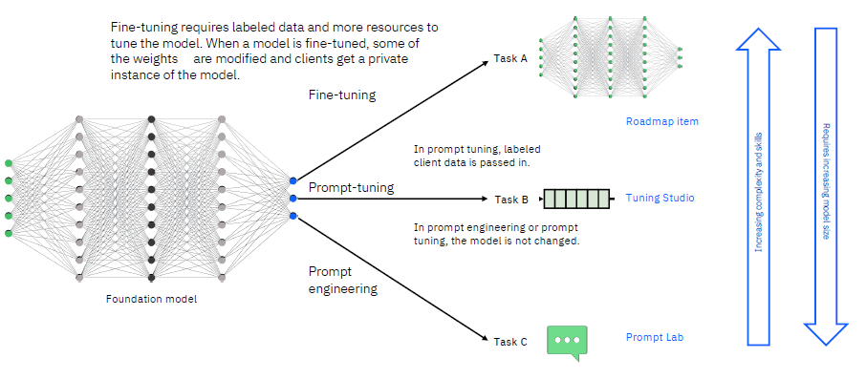

Slide 15
You can interact with foundation models in several ways, such as by:
Writing prompts (prompt engineering),
Training models,
Fine-tuning models,
Managing the model and its data.
Currently, not all features are available on the platform. In this course, you will focus on prompt engineering using the Prompt Lab, which is already available.
The foundation models on watsonx include those trained by IBM, as well as open-source models from Hugging Face. You can log into watsonx on the IBM cloud to explore models from other major companies like Google and Meta.
Your use case is a factor must you consider when choosing a foundation model.
IBM Foundation Models:
IBM has developed foundation models designed for trustworthy and efficient use in businesses. These models include:
Transparent pre-training: Models are trained using IBM’s trusted data.
Enterprise-relevant data: Trained on a large set of business-related data.
Legal and safety checks: Verified by IBM for safety and legal use.
Auditable data: Complete data history (lineage) for every model.
With watsonx.ai, you can train, validate, tune, and deploy AI models.

Slide 16
Key Features of watsonx.ai:
Leverage foundation models and generative AI to build solutions with less data, using advanced prompt-tuning tools, and access to a full development kit (SDK) and programming libraries (API).
Bring together AI developers with open-source frameworks and tools for automated and visual data science—all within a secure, trusted environment.
Accelerate the AI development process by having all the tools and resources in one place to train, validate, tune, and deploy AI models.
By using foundation models and generative AI in watsonx.ai, you can create AI applications much faster than with traditional machine learning models.
You can mix IBM-exclusive and open source data science tools in watsonx.ai.
Watsonx.ai Studio Features:
Access IBM's proprietary and open-source foundation models from Hugging Face.
Use zero-shot and few-shot learning in the prompt lab.
Tune pre-trained models for specific tasks using business data.
The watsonx.ai studio brings AI developers together and provides a reliable environment for building machine learning and foundation models faster. It offers:
A diverse set of data science tools, including IBM-exclusive, open-source, no-code, and low-code options.
The ability to create predictive models to help businesses make better decisions.
By having all the tools and resources in one place, you can speed up the process of developing AI models by coordinating machine learning and foundation model workflows effectively.

Slide 17
What is Prompt Engineering?
A prompt is the text or question you give to a foundation model to get an answer or result. For example, if you ask a foundation model to identify if a sentence has a positive or negative feeling (sentiment), that request is a prompt. Crafting a good prompt to get the desired result is called prompt engineering—a mix of creativity and technical skill.
Different Ways to Use Foundation Models
There are five main ways to work with a foundation model:
Zero-shot prompting – Asking the model to perform a task without giving any example.
One-shot prompting – Providing one example to help guide the model.
Few-shot prompting – Providing a few examples to guide the model.
Data-driven tuning (fine-tuning) – Adjusting part of the model's settings for a specific task.
Training a model from scratch – Building a new model by teaching it from the beginning, which uses a lot of resources.
The list above shows the methods from the least to the most resource-intensive. Writing prompts (zero-shot, one-shot, few-shot) is called prompt engineering. It's a bit like trying to guide someone by giving clear instructions. On the other hand, prompt-tuning is a low-cost way of adjusting a foundation model without retraining the whole thing. If you fine-tune or train from scratch, you are changing the model more deeply.
Prompt Lab in IBM watsonx.ai
The Prompt Lab in watsonx.ai is not like a chatbot (a program that responds to questions in a conversation). A chatbot tries to answer directly, but foundation models don’t work exactly like that. They add text to the input you provide, so you need to give clear instructions to guide them.

Slide 18
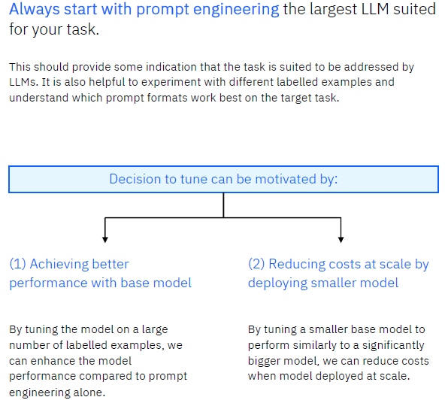

Slide 19
To create an effective prompt, consider using these elements:
Instruction: A clear command telling the model what to do.
Context: Additional information to help the model understand the task better.
Examples: Sample input and output to show the model what you expect.
Cue: Text that encourages the model to start generating the response you want.
Think of prompt engineering like giving instructions to a teenager who tries to interpret your directions in their own way. You need to be specific and clear to get the right results.
Important Note:
While hand-written prompts are useful, AI-generated prompts (which use numbers instead of words) can often be better. You can also build your own foundation model, but this takes a lot of computing power, time, and money. It might require powerful GPUs and cost tens of thousands of dollars over several days or weeks of training.
Benefits of Using watsonx.ai
The main advantages of using watsonx.ai include:
Combining AI tools: Bringing together predictive, prescriptive, and generative AI in one platform to streamline the AI lifecycle.
Empowering all users: Both coders and non-coders can work with open-source and visual tools in one unified environment.
Maximizing existing resources: It integrates with existing cloud and data setups without vendor lock-in (dependence on one provider).
Data flexibility: It connects and analyzes data from anywhere in the business, no matter where it's stored.
Operational AI: It supports AI development across different cloud environments.
Accelerating business growth: Helps scale the business by using advanced foundation models to improve operations faster.
Watsonx.ai is designed to help businesses use AI effectively, making the process easier and more efficient for everyone involved.

Slide 20
Imagine you’re going from your home in Durham, North Carolina, to your dentist’s office in Apex, North Carolina. You have two routes to choose from:
The toll road (16.5 miles, 20 minutes): It’s fast, but you have to pay for it.
The longer route without tolls (22.1 miles, 31 minutes): It’s free, but it takes more time.
Which route should you take? It depends on your goals:
Do you want to save time or money?
Is it important to arrive on time for your appointment?
What happens if you’re late?
Comparing EDW and Data Lake
Using an Enterprise Data Warehouse (EDW) is like taking the toll road: It’s fast and reliable, but expensive.
Using a data lake is like taking the longer, free route: It’s cheaper but may take more time, and you may face delays (such as passing by a busy airport).

Slide 21
What Is a Data Lakehouse?
The data lakehouse is a middle option. It combines the best of both the data warehouse and the data lake:
It’s flexible like a data lake but performs faster like an EDW.
It supports both structured and unstructured data (like numbers and text).
It works with popular programming languages like Python, R, and SQL.
In our analogy, the data lakehouse is like a 17.4-mile route that takes 25 minutes—a balance between speed and cost.
Key Features of a Data Lakehouse:
Combines the flexibility of data lakes with the speed and structure of data warehouses.
Handles different types of data (structured and unstructured).
Supports multiple programming languages and is suitable for big data analysis.
Enterprise data warehouse is a storage system is the most expensive to operate.
What Is watsonx.data?
Watsonx.data is IBM's solution that uses the data lakehouse architecture. It combines the flexibility of a data lake with the fast performance of a data warehouse, making it ideal for managing large amounts of data. You can still use traditional EDWs or data lakes, but now you have the data lakehouse option with watsonx.data.

Slide 22
Key Components of watsonx.data:
Multiple Engines: It uses powerful tools like Presto and Spark to process big data quickly and efficiently.
Governance: Built-in features ensure data management is in line with standards and policies (compatible with IBM Knowledge Catalog).
Open Formats: Supports open data file formats (Parquet, ORC, Avro, Apache Iceberg), making it easy to share data between different systems.
Object Storage: Cost-effective and simple storage that works across different cloud environments.
Hybrid-Cloud Deployment: Flexible deployment across both cloud providers and on premise systems, supported by Red Hat OpenShift.
Data Warehouse vs. Data Lake Summary:
Data Warehouse (EDW): Centralized system that allows fast analysis of large amounts of data, but it’s more expensive.
Data Lake: Stores massive amounts of data but can be slow and hard to organize.
Data Lakehouse: Combines the best of both worlds—flexibility and cost-effectiveness of a data lake with the performance of a data warehouse.

Slide 23
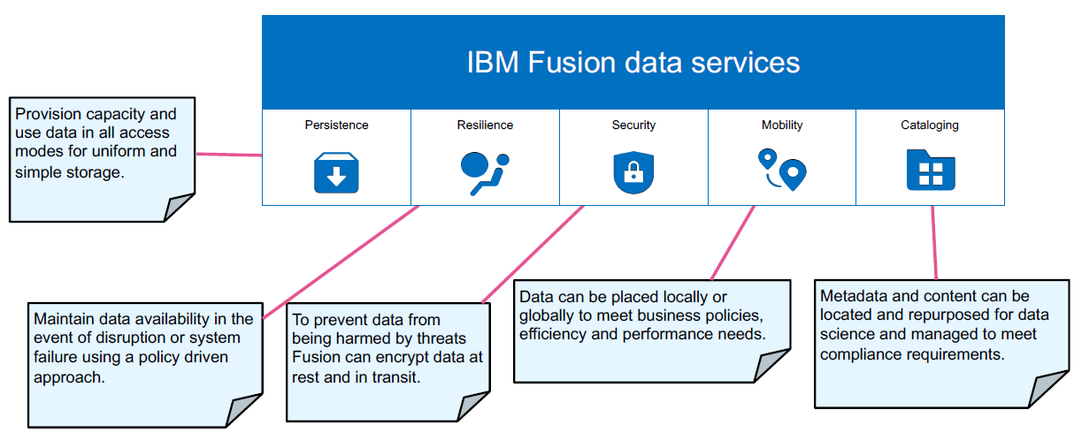

Slide 24
Benefits of Using watsonx.data:
Combines data storage and management features of both data warehouses and lakes.
Provides fast and reliable data processing with multiple engines.
Ensures data security and management with built-in governance.
Offers flexible storage options and deployment across different environments.
The Watsonx.data Stack
In the watsonx.data system, the bottom two layers of the structure represent the underlying infrastructure. These layers support the top three layers, which handle the core functionality of watsonx.data.
Orchestrate data delivery from disparate sources for self-service consumption
Data Product Hub eases the on boarding and sending of data products from various IBM and third-party data sources. Through a well-designed set of connectors, it enables data producers to package data products from a wide range of source systems, including data lakehouses such as IBM watsonx.data.

Slide 25
Generative AI places enormous demands on data quality and availability.
A modern data sharing solution like IBM Data Product Hub is a crucial
investment in building the trusted data foundation you need to support, scale
and accelerate AI.
IBM Data Product Hub serves as a critical connection point between your data foundation and AI platforms such as IBM watsonx.
IBM Data Product Hub can act as a storefront for data products sourced from IBM watsonx.data, which is built on an open data lakehouse architecture. This allows your organization to enable high-scale data sharing with a data-as-a-product approach.

Slide 26
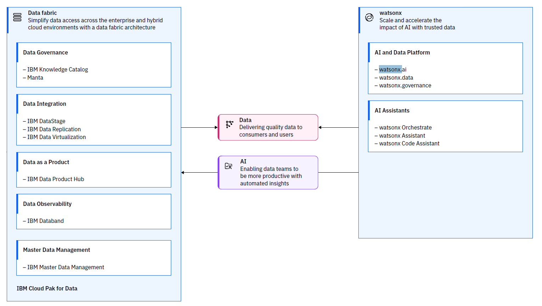

Slide 27
Advantages of Using a Data Lakehouse (Compared to EDW or Data Lake):
Stores all types of data: A data lakehouse can hold both structured (like spreadsheets) and unstructured data (like videos or text).
Lower cost: It’s generally less expensive to maintain than traditional data warehouses.
Open formats: It uses open data formats, making it easier to share data.
Huge storage capacity: It can store terabytes and petabytes of data (very large amounts).
Flexible for analysis: It’s perfect for analytics, business intelligence, AI, and machine learning.
Multiple query engines: It supports different tools to process data quickly and effectively, specific to IBM’s technology.
What Can You Do with watsonx.data?
A data lakehouse serves as a central place to manage and analyze huge amounts of data. It’s useful for processing structured and unstructured data like videos, texts, social media, and sensor data. This type of data can drive insights for apps, analytics, AI, and more.

Slide 28
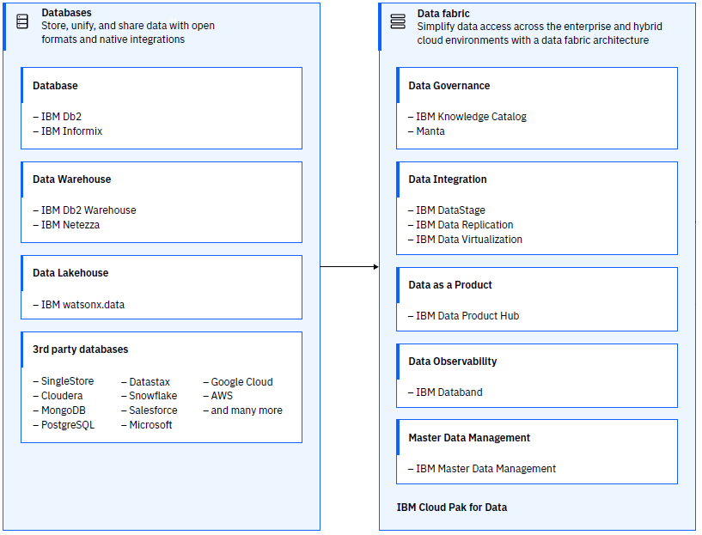

Slide 29
Key Actions You Can Take:
Access: You can reach all your data across your cloud environments, making it easy to use data wherever it’s stored.
Accelerate: Quickly gain insights. In just a few clicks, you can connect to your existing data and start using query engines for analysis.
Reduce Costs: Save money by optimizing the use of different query engines and storage options.
Core Components of watsonx.data:
Multiple Query Engines: It includes Presto, Spark, Db2, and Netezza to handle different data tasks.
Shared metastore: Keeps track of metadata (information about your data) to make data management easier.
Open Formats: Stores data in low-cost storage that can be accessed by multiple query engines and connected to other data sources.
With watsonx.data, you can share data easily for analytics and AI, improve efficiency by using the right query engines, and generate insights with generative AI. The system has a simple console that allows you to connect to your data in the cloud and start using tools within minutes.

Slide 30
Benefits of Using watsonx.data:
Easy access: Makes it simple to reach all your data across cloud environments.
Supports various tasks: Handles a wide range of data workloads.
Cost savings: Reduces the cost of running your data warehouse by using the best tools for each task.
Scalability: Separates data storage and computing power, making it easy to scale up when needed.
Reduces data duplication: Lowers the chance of storing multiple copies of the same data.
Ensures compliance and security: Built-in governance features help ensure that data stays safe and meets legal requirements.

Slide 31
Watsonx.governance
Why Use watsonx.governance?
Let’s use a search engine powered by generative AI to explore 10 major milestones in the recent development of global AI regulations.
Simple Explanation of AI Governance and Regulations
GDPR
The General Data Protection Regulation (GDPR) is a rule from the European Union (EU). It focuses on privacy and how people's personal information is protected across Europe.
National Data Strategy (NDS)
The National Data Strategy is the UK’s plan to build a strong economy using data, while also making sure the public trusts how data is used.
US Federal Trade Commission (FTC)
The FTC in the US has shared guidelines for making sure AI systems are truthful, fair, and unbiased.
Why Regulations Matter for Companies
If a company wants to work internationally, it needs to follow both internal rules and external laws. Many countries are creating new laws to regulate AI quickly. If companies don't follow these rules, they could face huge fines and lose their reputation. That's why it's important for businesses to control how they create, use, and manage their AI systems. IBM’s watsonx.governance helps organizations ensure their AI is responsible, transparent, and explainable.
Why AI Governance is Important
Having a good AI Governance plan helps companies avoid risks and ensures they follow ethical guidelines and government regulations.

Slide 32
Watsonx Governance Overview
The watsonx.governance system includes three main services:
Model Documentation: Keeping records of AI models.
Model Risk Governance: Managing risks related to AI models.
Evaluation and Monitoring: Checking AI models for fairness and accuracy.
People are at the center of AI governance—data engineers, scientists, and AI engineers build models, while senior management ensures that these models meet compliance and ethical standards.
How Watsonx.governance Works
Watsonx.governance extends AI governance from basic AI to more advanced systems like generative AI and foundation models. It allows organizations to automate AI lifecycle management, reducing risks and improving compliance.

Slide 33
What Can You Do with Watsonx.governance?
With IBM watsonx.governance, companies can:
Operationalize AI Governance: Speed up AI model development by using automated tools that bring together different platforms.
Enable Responsible AI: Automatically document how a model was built, and ensure it’s fair and unbiased.
Support Regulatory Compliance: Ensure that models follow rules and regulations for fairness, transparency, and compliance.
It’s built to meet government rules and ethical standards by tracing the origin of data and models, making it easier for audits.
Additional Benefits:
Comprehensive: Governs the entire AI lifecycle and captures important information (metadata) at each step.
Open: Supports models created in third-party tools.
Automatic: Automatically tracks how data and models change over time.

Slide 34
Advantages of Using Watsonx.governance
Monitor and Control: Manage AI models across their entire lifecycle.
Support Third-Party Tools: Work with models created in other software.
Efficient Reporting: Easily generate reports using captured metadata.
Better Visibility: Increase communication among stakeholders and give an up-to-date view of models.
Detect Bias: Automatically alert stakeholders if models show bias or drift.
Automate Policies: Turn external regulations into rules that are automatically enforced.
Scalable Governance: Use tools that manage risk and compliance across a large company.
Connect Internal and External Rules: Align company policies with external regulations.

Slide 35
IBM Watsonx Platform
Watsonx is IBM’s platform designed to bring AI and data management together for businesses.
Foundation models are large AI models trained on vast amounts of data that can be adapted for many tasks with minimal additional training.
Watsonx is a data and AI platform built for the enterprise, which is comprised of three components: watsonx.ai, the solution for working with foundation and machine learning models; watsonx.data, which is a governed, open, hybrid data lakehouse; and watsonx.governance, which provides transparency and trust to manage and govern AI.
The watsonx platform has evolved to help our customers go from pilots to essential, production-ready AI systems, focusing on accelerating the way companies work with AI; simplifying data access for personalizing generative AI; and finally, helping companies govern and manage their AI.

Slide 36
IBM has open sourced most advanced and high-performance LLM model known as Granite. IBM has trained them from the ground up, working closely with privacy officer and AI ethics committee to ensure integrity, trust, and governance at every stage of our build process. So as to ensure that the models are not only reliable, but also performant.
IBM has an upcoming addition of a new query engine, Presto C++, and additional query optimization capabilities within watsonx.data. By leveraging these technologies, they have been able to offer better value than other leading vendors, with the same query execution time but at less than 60% of the cost.

Slide 37
One of the key challenges in scaling AI is delivering the right data to the right users.
A solution that has been devised to address this challenge is the IBM Data Product Hub.
This cutting-edge solution enables seamless, secure, and governed sharing of data products for AI across an organization.
IBM Data Product Hub lets you easily connect to a variety of different data sources to create new data products. You can see a variety of different assets here, including the ones we have for our lakehouse watsonx.data.
Reusable data products are also essential for AI builders, as they enable data consumers to effectively discover and reuse governed data across multiple sources, like watsonx.data, for their AI and data-driven use cases.
Now you can even discover and access all your data, refined with detailed metrics on the quality, access and health of different data products. This allows you to have a holistic view of how data products are being used across the enterprise.
Now let's move on to the need for corporate governance. It's no surprise that most organizations are still in the experimental stage with generative AI projects, highlighting the risks associated with it, including bias, hallucinations and a lack of trust and transparency in how decisions are made.
Another challenge is the need to navigate an ever-changing regulatory landscape, such as the recent EU AI Act, the world's first comprehensive AI law that provides companies with fines of up to €35 million for non-compliance.
IBM has formulated watsonx.governance to help our customers build responsible and transparent AI, putting governance at the center of the generative AI lifecycle.

